Slide 1


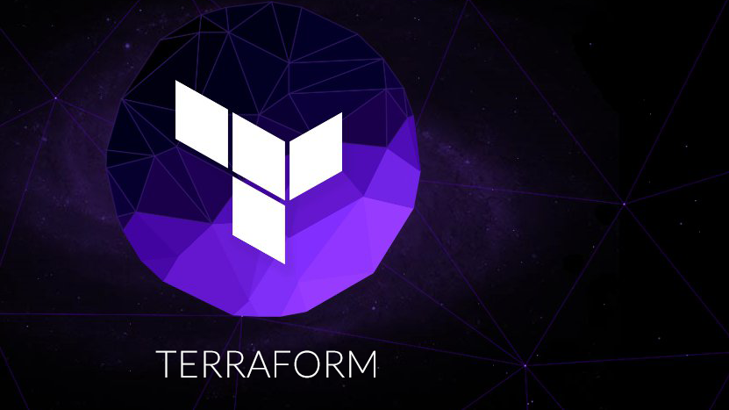
Introduction to Terraform
Jake Adams
https://bit.ly/jaketerraform

Slide 2
WHAT?
“Terraform is an open-source infrastructure as code software tool that provides a consistent CLI workflow to manage hundreds of cloud services. Terraform codifies cloud APIs into declarative configuration files.” – Terraform Website

Slide 3
Why Infrastructure as code?
Code
Written documentation
Build reusable block, abstract away complex concepts
Source Control
History
Go back to previous version
Collaborate
Change log
AutomatIon
Less error prone
Quicker
Repeatable
Have everything in case it's destroyed
Don’t have to worry as much about backups
Possible because of virtualization and cloud advancements.
Enabled cloud-native workflows like creating new infrastructure for each deployment.

Slide 4
Why Terraform vs...
Azure Resource Manager (ARM) or AWS CloudFormation Templates– Terraform is easier syntax to read and write
PowerShell or other scripts – Terraform is a declarative, desired state syntax and only applies changes that are needed.
Bicep – Terraform supports multiple cloud and other providers
Pulumi – Terraform is a configuration language that provides easier onramp for non-developers.

Slide 5
Demo

Slide 6
Resources to Learn More
Pluralsight
Terraform website - https://terraform.io
https://learn.hashicorp.com
Code and Slides - https://bit.ly/jaketerraform

